Slide 1
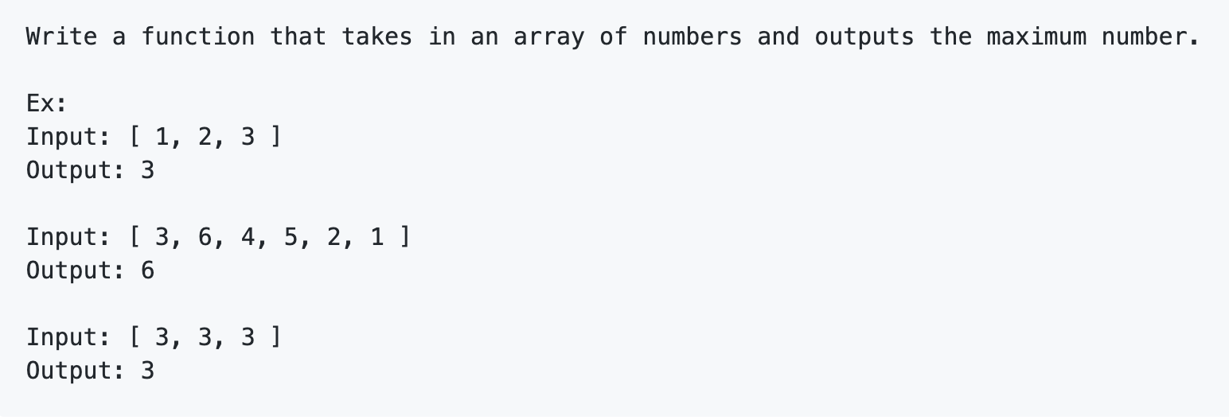
Morning Check-In ✔

Slide 2
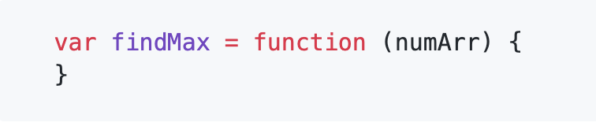
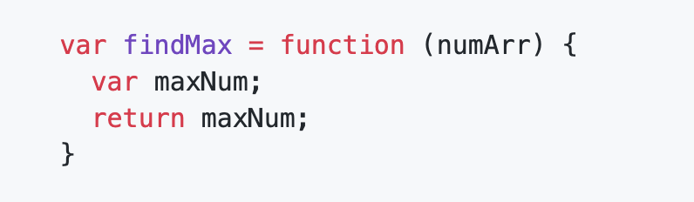
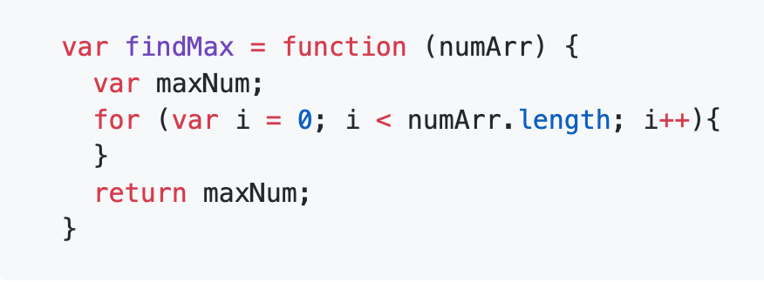
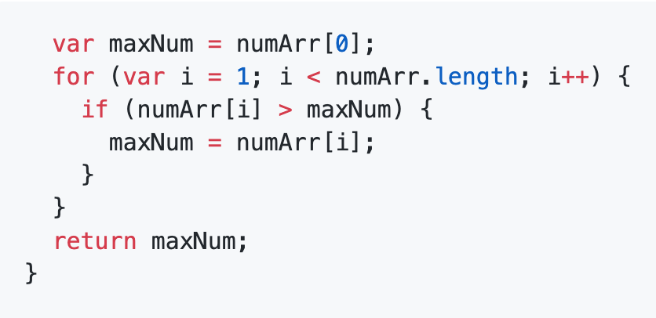
Morning Check-In ✔
My function needs to return some number, so let's add a return:
Find the maximum number in an array, so I need to check every number in the array. I'll use a for loop to iterate through the array.

Slide 3
Event Handling
& Client-side Storage

Slide 4
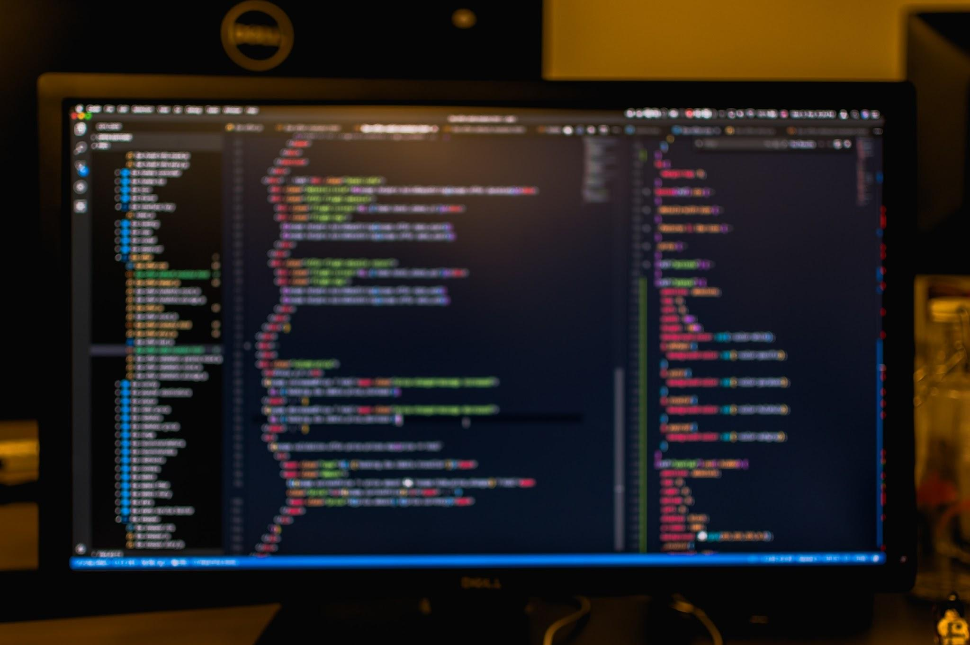
Today’s Objectives
In today’s class we’ll be introducing:
Use event listeners.
Prevent default form behavior with event.preventDefault().
Stop the propagation of events.
Dynamically generate DOM elements whose events are delegated.
Use local storage

Slide 5
Timers and Intervals
Where are timers used in applications?
Countdowns
Calendars
Games
setTimeout and setInterval are two methods that allow for us to execute code based on time.
These two methods are actually above the document object and are attached directly to the window.
When using either of these timer methods, The first parameter is a function to be executed. The second parameter indicates the amount of time in milliseconds before execution.
setTimeout will execute the body of the function one time, once the allotted amount of time has passed.
setInterval will execute the body of the function every X amount of milliseconds as specified in the second argument to the setInterval function.
if we do not clearInterval, the interval would continue to run indefinitely. We stored our setInterval function in a variable so we could pass that instance into our clearInterval, stopping execution.
setTimeout has its own method for stopping execution, clearTimeout.

Slide 6
Students Do: 09-Stu_SpeedReader
09-Stu_SpeedReader | 30 mins
In this activity you are going to create a speed reading application. It will input a single word on the screen at a time, changing to the next word after 1 second. This equates to reading at 60 Words Per Minute (WPM).
Instructions
* The app should countdown from 5, and when the countdown is finished it should print one word to the screen every second. Each word replaces the other.
* Open `index.html` and create the necessary HTML. You will need at least 3 elements.
* Open `script`.
* The two function names have been created for you, as well as a poem to speed read.
* Fill out the necessary code that would create a countdown timer. When that timer completes, it should disappear and speed reading should begin.

Slide 7
Review: 09-Stu_SpeedReader
In our prepareRead function we store our interval in a variable so we can clear it later.
var timeInterval = setInterval(function() {
When the timer has run out, we empty the textContent of the timerEl and then execute our speedRead function.
if (timeLeft === 0) {
timerEl.textContent = " ";
speedRead();
clearInterval(timeInterval);
}
We used a prompt to ask the user to enter the speed at which they would like to read, we passed that response in as the second argument of our speedRead setInterval.
}, speed);
As opposed to a fixed value, i.e.,
}, 1000);
In the beginning of our speedRead function we append our bodyEl, generated via createElement, to the mainEl of our HTML page.
mainEl.append(bodyEl);
We use an if statement to check whether the piece we are reading is over. When words[i] begins to evaluate to undefined and not a word, we terminate the interval via clearInterval. As long as words[i] evaluates to a word from our array, we make the content of our mainEl reflect that.
if (words[i] === undefined) {
clearInterval(poemInterval);
} else {
mainEl.textContent = words[i];
i++;
}

Slide 8
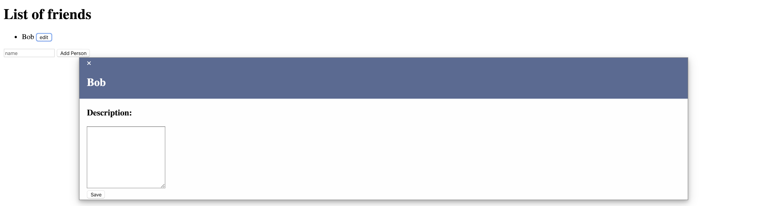
Demo Events
Examine: https://coding-boot-camp.github.io/fs-ground-04-web-APIs-event-demo/
We can add people to the list.
Clicking edit next to any name opens a modal.
We can add details about the person and save the data.
We can return to any person on the list, and see that the details are still there.
📝 Our form is not routing us to a new page! How?

Slide 9
Demo Events: Pseudocode Modal Demo
Examine: https://coding-boot-camp.github.io/fs-ground-04-web-APIs-event-demo/
What is the first thing our app needs so a user can add another user to the list?
We need an input field for name.
We need some way to gather the data from name when Add Person is pressed.
When a user adds a new user to the HTML form and clicks Add Person, what happens next?
We need to dynamically create a new list item.
We append an edit button to that new list item.
Then we append the new list item to the main people list.
What needs to happen when a user clicks the "edit" button?
The modal needs to display on the page, and the contents of the modal should populate with details about the person that we clicked.
What needs to happen when a user clicks the "edit" button?
The modal needs to disappear.
We need some way of keeping track of which person has which description.

Slide 10
10-Ins_Onclick: On Click Demo
We assign each queried element to a variable so that we can reuse it.
var themeSwitcher = document.querySelector("#theme-switcher");
var container = document.querySelector(".container");
addEventListener is the DOM method responsible for listening to events on an element.
addEventListener has 2 required parameters: The type of event to listen for and a callback function to execute when that event is triggered.
themeSwitcher.addEventListener("click", function() {
if (mode === "dark") {
mode = "light";
container.setAttribute("class", "light");
} else {
mode = "dark";
container.setAttribute("class", "dark");
}
});

Slide 11
Students Do: 11-Stu_Onclick
11-Stu_Onclick | 10 mins
addEventListener On Click
In this activity, we are going to create a button that increments a counter when clicked.
Instructions
* In a file called `index.html`, create a button containing the string "Increment".
* In a file called `script.js`, create an event listener with a callback that increments the counter and displays the updated count on the webpage.
* Add a button that decrements the counter when clicked.
Bonus
* Add some code to ensure that the count never gets below 0.

Slide 12
Review 11-Stu_Onclick
Clicking on the increment or decrement buttons raises or lowers our number dependant on which button we click.
The count in the middle gets updated every time the button gets pressed.
The count never falls below 0.
We initialize global variables for count variable, incrementEl, and the decrementEl elements in DOM.
var count = 0;
var incrementEl = document.querySelector("#increment");
var decrementEl = document.querySelector("#decrement");
The second argument of addEventListener is an anonymous callback function. This function will execute the body of the callback each time the event is triggered.
incrementEl.addEventListener("click", function() {
count++;
setCounterText();
});
To complete the bonus we need a conditional that ensures that the count only decrements if the current value is greater than 0.
decrementEl.addEventListener("click", function() {
if(count > 0) {
count--;
setCounterText();
}
});

Slide 13
Intro to event.preventDefault
12-Ins_Preventing_Default_Events/script.js
We pass the callback to addEventListener, which has a parameter that represents the event object.
submitEl.addEventListener("click", function(event) {
event.preventDefault();
console.log(event);
var response = "Thank you for your submission " + nameInput.value + "! We will reach out to you at " + emailInput.value + ".";
submissionResponseEl.textContent = response;
});
12-Ins_Preventing_Default_Events/index.js
Enter values into the input fields and click on the submit button.
Demonstrate that the entire click object appears in the console.
In the console, expand the event object and let students know that the event object is a large object that contains lots of data about the mouse event.
ctrlKey and altKey are booleans used to describe whether or not the user was holding down the key while they clicked. (Mouse Event section of Mozilla's Documentation.)
We click the button and we submit the form.
When this happens, the event object appears in the console for a brief moment and all inputs are cleared.
This is the default behavior for form submissions. In order to prevent this default behavior, we use the event.preventDefault method.

Slide 14
Students Do: Tip Calculator
Tip Calculator | 15 mins | Preventing Default Events
In this activity, we are going to create a form that calculates a suggested tip amount based off of the total of the bill.
In a file called `index.html`, create a form with the following elements:
1. An input for the total price of the meal
2. An input for the tip percentage
3. A button to calculate the tip
* In a file called `script.js`, create an event listener that utilizes the values from the input fields to calculate the reccommended tip and the new total of the bill with tip included.
* Once these values are calculated, display them on the page.
Bonus
* Add a feature that gives users the option to evenly split the total between any number of people. Make sure to add code to ensure that the split total will be rounded to two decimal places.
Hint In JavaScript, we have a function that rounds a number to a given point called `toFixed()`

Slide 15
Review: Tip Calculator
13-Stu_Preventing_Default_Events/Solved/index.html
The built in buttons are due to the attribute type=number. The input field also has the attribute min=0 which prevents the user from decrementing once they reach zero.
13-Stu_Preventing_Default_Events/Solved/script.js
No functions are actually executed until the bottom of the file.
Writing a named function helps separate the logic from the event listener.
Creating a named function also allows the function to be reused throughout the program. Any other function could call addTip if needed.
We still have access to the click event inside addTip
We get the values from the total and tip percentage input fields, then call calculateTip. Remind the students that the value from input fields of type=text are always strings.
toFixed(n) is a number prototype method that returns a number and rounds it to the nth decimal place. Here, n is a variable that we use to describe an unspecified number in a series of numbers. We use this method because we want our total to be rounded to the nearest cent.
Even though total and tipPercentage are strings, we can still multiply them. This is because in JavaScript, the * operator coerces both arguments from strings into numbers before multiplying them. This is also the case for all arithmetic operators except for addition.
Since both total and tipAmount are strings, we need to convert them into numbers before adding them. Remind students that the + operator concatenates strings.
To do this, we use a global method called parseFloat() which takes a string as an argument and returns a decimal number, or floating point number.

Slide 16
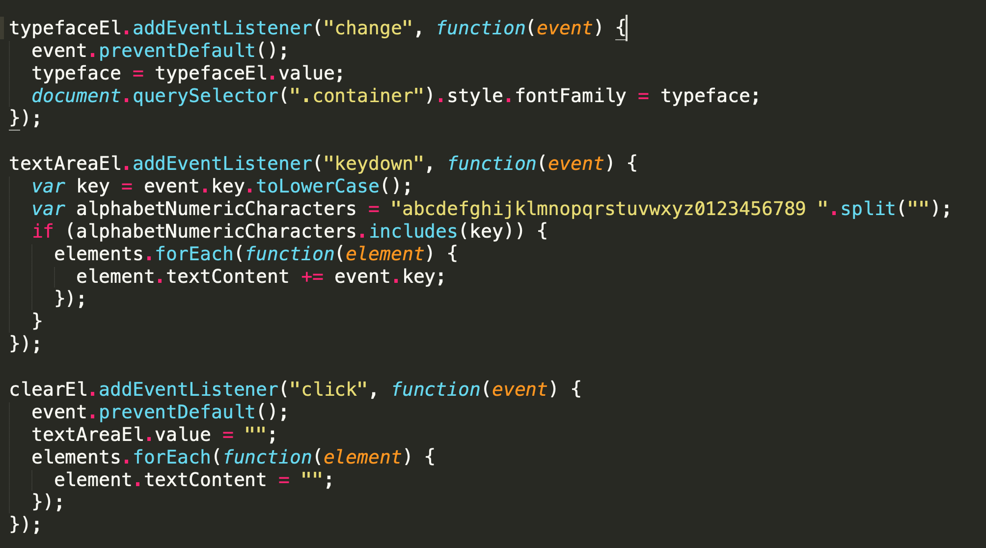
key events
<form>
<select id="typeface">
<option value="serif">
serif
</option>
<option value="sans-serif">
sans-serif
</option>
</select>
<div style="margin-top: 50px;">
<textarea
id="textarea"
placeholder="Your input" >
</textarea>
<div>
<button id="clear">
Clear
</button>
</div>
</div>
</form>
The form element only needs <select>, a <textarea>, and a <button> to clear the text.

Slide 17
Students Do: Listening For Other Events
15-Stu_Other_Events/Unsolved | 10 mins
In this activity, we are going to create a webpage that will allow us to view some meta data about different kinds of events.
Open the `index.html` file in your browser and take a moment to study the application.
Take a moment to study the code in `index.html` then add the following functionality to the application:
1. The select element should trigger the `toggleDisplay` function in `script.js`.
2. If `key` is selected, the event's code, key, and status (keydown or keyup) should be displayed in the `#key-events` div when the user presses a key anywhere on the document.
3. If `click` is selected, the text content of the event's target, and the cursor's x and y coordinates should be displayed in the `#click-events` div when the user clicks the anywhere on document.
Bonus
If time permits, take a moment to research some other JavaScript events.

Slide 18
Review: Listening For Other Events
15-Stu_Other_Events/Solved/index.html
If we click the on a spot that doesn't have an html element, the textContent from each element on the page is appending to the target span.
Why does clicking on a blank spot on the page adds the entire page to target?
This is because the textContent property returns all text content from the DOM node and its children.
15-Stu_Other_Events/Solved/script.js
We grab the key and code properties and append them to their respective span elements on the page.
Since this function is only ran if the keydown activity, we can explicitly set the status text content to be KEYDOWN Event.
Remind students that although we did not write this function inline with the event listener, we still have access to it
function keydown(event) {
var keyPress = event.key;
var keyCode = event.code;
document.querySelector("#key").textContent = keyPress;
document.querySelector("#code").textContent = code;
var status = document.querySelector("#status");
status.textContent = "KEYDOWN Event";
}

Slide 19
Event Bubbling and Propagation
Each div has an event listener set up that will change its background color to the color specified.
What will happen when the innermost button is clicked?
We will see that every div changes colors
Why?
We have instantiated an event listener on a div that has parent elements which also have event listeners.
When an event occurs on an element with an event listener, it bubbles up through each of its parent DOM nodes until it reaches the top. We can prevent this behavior by using a method called event.stopPropagation.
stopPropagation is taking the click event and preventing it from bubbling up.

Slide 20
Students Do: Event Bubbling
17-Stu_Event_Bubbling/Unsolved | 10 mins
In this activity, we are going to create an image carousel that allows us to cycle through images.
Instructions
In a file called `index.html`, create a div that contains two buttons: `previous` and `next`. The carousel should support the following features:
1. When the `next` button is clicked, the image should change to the next image in the array. If the image has reached the end of the array, the image should start over at the start of the array.
2. When the `previous` button is clicked, the image should change to the previous image in the array. If the image has reached the start of the array, the image should start over at the end of the array.
3. When the user clicks on an image, they will be navigated to the url that hosts that image.

Slide 21
Review: Event Bubbling
First, we initialize our element variables and create an array to hold the links to the images. We also initialize our background image.
box.style.backgroundImage = "url('https://picsum.photos/300/200')";
var index = 0;
var images = [
"https://picsum.photos/300/200",
"https://picsum.photos/300/201",
"https://picsum.photos/300/202",
"https://picsum.photos/300/203"
];
When the image container is clicked, we use window.location.href to navigate the browser to the url that hosts the image.
box.onclick = function(event) {
window.location.href = images[index];
};
Next, we set up the navigate function, which handles click events on both the previous and next buttons. Alternatively, students may have created two separate functions to handle each button click.
function navigate(direction) {
index = index + direction;
if (direction === -1 && index < 0) {
index = length - 1;
}
if (direction === 1 && !images[index]) {
index = 0;
}
current = "url('" + images[index] + "')";
box.style.backgroundImage = current;
}

Slide 22
Review: Event Bubbling
We add an event listener to each button, calling event.stopPropagation(); to prevent the click event from bubbling up to our image container.
next.addEventListener("click", function(event){
event.stopPropagation();
navigate(1);
});
prev.addEventListener("click", function(event) {
event.stopPropagation();
navigate(-1);
});
navigate(0);

Slide 23
Event Delegation Demo
Event Delegation: The technique of listening for events on a parent element, then delegating those events differently, depending on the target.
What if we need to assign event listeners to several objects on the page? Is there a way that we can easily handle all of these events without duplicating code?
Index.html
Where they would set up the event listeners?
Script.js
Note that the event listener was added to the entire list. Then, within the callback, we determine whether or not the clicked item was a button or not by using event.target.nodeName. This technique is known as event delegation.
Instead of writing a for loop and adding event listeners to every button element, we added an event listener to its parent element.
Simplify our code
In some cases, it reduces the need for event.stopPropagation. Ex: If click events from a child element is triggering the event on its parent, we can set up a conditional that identifies the target, then executes a callback accordingly.

Slide 24
Students Do: Event Delegation
19-Stu_Event_Delegation/Unsolved | 15 mins
In this activity, we are going to create a friends list that allows us to edit information about that friend in a modal.
Take a moment to study the code in `index.html`. You will not need to add any additional code to this file. Additionally, all of the CSS has been provided.
In `script.js`, add support the following features:
1. When the `Add Person` button is clicked, the person should be added to both the people array and the list elements.
2. If `edit` is clicked, event delegation should be used to handle the click event.
3. When the user clicks on edit, the modal should appear with the modal header property already populated with the person's name. If a description exists, the textarea should be populated with the person's description. If not, the description should be left blank.
4. When the `save` button is clicked, the description of the current person should be updated in the people array.
Bonus
* Use event delegation to make the modal close if the user clicks away from the modal.

Slide 25
Review: Event Delegation | Peer Review 7 min
In handleClick, we check to see if the element clicked is a span. This is sufficient because this is the only span element on the page at this time.
Then we set up variables for the name and description of the person that we clicked on.
The textContent of the modal header is set to the name and the value of the description textarea is set to any existing description. The logical OR operator ensures that the description is set to an empty string if the value in our array is undefined.
function handleClick(event) {
if (event.target.matches("span")) {
modalEl.style.display = "block";
currentId = parseInt(event.target.parentElement.id);
var name = people[currentId].name;
var description = people[currentId].description;
modalNameEl.textContent = name;
descriptionEl.value = description || "";
}
}
saveBtn.addEventListener("click", function(event) {
event.preventDefault();
people[currentId].description = descriptionEl.value;
close();
});
document.addEventListener("click", function(event) {
if (event.target === modalEl) {
close();
}
});

Slide 26
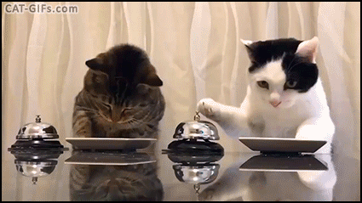
It’s Lunch Time!
Return @ XX:XX

Slide 27
Preview Client Side Storage
Our TODO List
We can add items to our todo list.
We can complete items on our todo list.
When we close the browser tab and reopen the application, we see that our todos are still there. Magic!
When we submit an item to our todo list, where does it go?
Our items are stored in the browser. So far none of the applications we've worked on have had any kind of persistent data. When an application was refreshed in the browser, all of its state was reset.
What would allow that?
A web API. Specifically client side storage.

Slide 28
Todo Local Storage Pseudocode
https://coding-boot-camp.github.io/fs-ground-04-web-APIs-todo-demo/index.html
What is the first thing our app needs so a user can submit a new todo?
A form and an event listener that listens for new todo submissions when enter is pressed.
When a user adds a todo to the HTML form and hits enter, what happens next?
We dynamically create a new list item, append a "complete" button and append that new list item to the main todo list. Our app also adds the new todo to local storage.
What needs to happen when a user clicks the "complete" button?
We listen for clicks on the complete button, remove the todo from the page and local storage, then reload the page with the current data.

Slide 29
Todo Local Storage Pseudocode
Create an HTML page with a form and an unordered list that holds our list items.
Create an event listener on our form that listens for new submissions.
On submit create a new list item, append a "complete" button and append that new list item to the main todo list.
Save the data to local storage.
Render the current data to the page.
Listen for clicks on the complete button, remove the todo from the page and local storage, then reload the page with the current data.

Slide 30
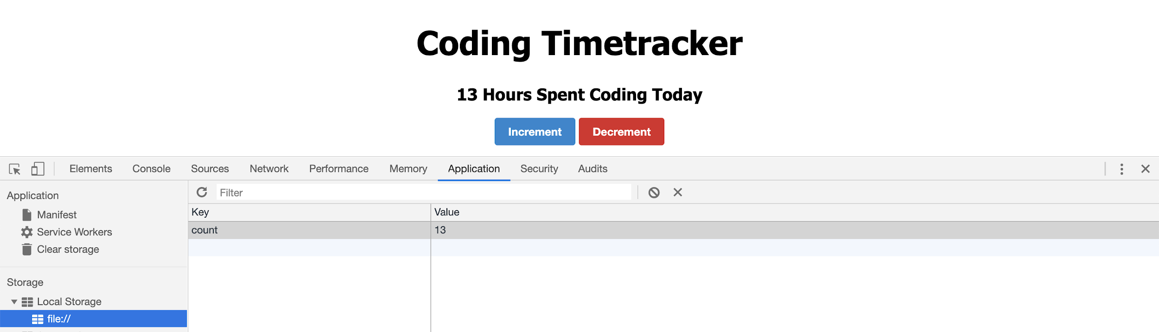
Demo Local Storage
20-Ins_Local-Storage-Counter/Unsolved |
Is this a database?
No, this is client-side storage. Data is stored in the client or browser, while a database would require a server.
What kind of information would you expect to see stored on the client as opposed to the server?
Personal preferences.
Shopping cart data.
Login session data. Even though user account credentials and information are stored on a server, the client needs to keep track of the fact that the user is still logged in across page refreshes and browser sessions.
What would you not want to store in the client?
Sensitive information, such as credit card numbers, social security numbers and passwords.

Slide 31
Students Do: Event Delegation
21-Stu_Local-Storage-User/Unsolved | 15 mins
You have been provided with a sign up form that successfully submits an email and password.
You're job is to write code that saves the email and password to local storage and renders the last submission to the page.
Instructions
In your `signUpButton` event listener you will need to:
Save the user to localStorage.
In the `renderLastRegistered()` function you will need to:
Fill in code here to retrieve the last registered credentials from local storage.
If the last registered is null, return early from this function.
Else set the text of the `userEmailSpan`, `userPasswordSpan` to their corresponding values from local storage.
Hints
Make sure you call `renderLastRegistered()` after you set your `localStorage`.

Slide 32
Review: Event Delegation
The first thing we need to do is save the form data with:
localStorage.setItem("email", email);
localStorage.setItem("password", password);
Now that we are persisting data to localStorage, let's set and return our last user's data inside our renderLastRegistered() function.
We access our local storage data and set the email and password to a variable. We then check if the email and password is null and if so, return early. var email = localStorage.getItem("email");
var password = localStorage.getItem("password");
if (email && password === null) {
Return;
}
If our data is not null, we set the text of the userEmailSpan anduserPasswordSpan to their corresponding values from local storage.
userEmailSpan.textContent = email;
userPasswordSpan.textContent = password;
With our renderLastRegistered() function complete, we can now call it inside our signUpButton event listener after we set our localStorage when a form is submitted.
localStorage.setItem("email", email);
localStorage.setItem("password", password);
renderLastRegistered();

Slide 33
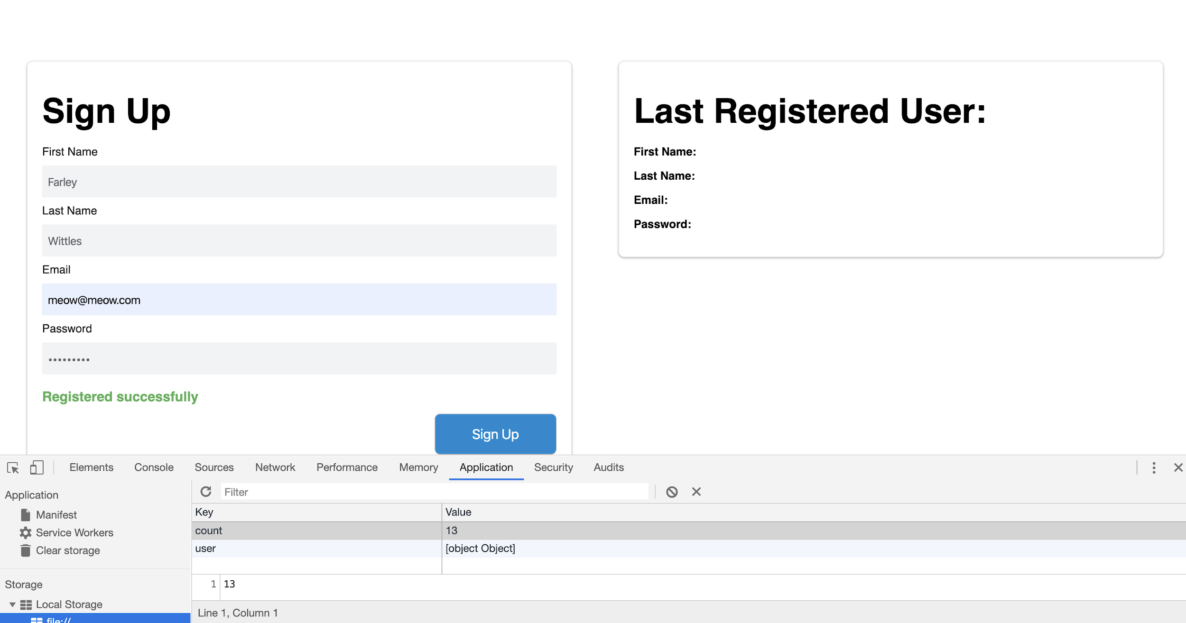
Local Storage with Uh-oh
var user = {
firstName: firstNameInput.value.trim(),
lastName: lastNameInput.value.trim(),
email: emailInput.value.trim(),
password: passwordInput.value.trim()
};
We are then setting this object into local storage.
localStorage.setItem("user", user);

Slide 34
Students Do: Local Storage With Objects
21-Stu_Local-Storage-User/Unsolved | 7 mins
You have been provided with a sign up form that successfully submits user data and creates an object containing the data. Your job is to save this data to local storage and render the last submission to the page.
Instructions
Navigate to the MDN Docs on [JSON Stringify](https://developer.mozilla.org/en-US/docs/Web/JavaScript/Reference/Global_Objects/JSON/stringify).
Use the information there to convert your object to a string format.
You will be working only inside of your `script.js` file.
Inside your event listener modify `localStorage.setItem("user", user);` and `localStorage.getItem("user");` so they save and render the data.

Slide 35
You Made it!

Slide 36

Questions?
Comments Concerns…?

